Slide 1
MVVM
Advanced Native Mobile Programming Week 4 Teknik Informatika - Universitas Surabaya

Slide 2
Topics
MVVM Concept
Tutorial: View, Model, ViewModel

Slide 3
THE CONCEPT
1
Lifecycle, LiveData, MVVM

Slide 4
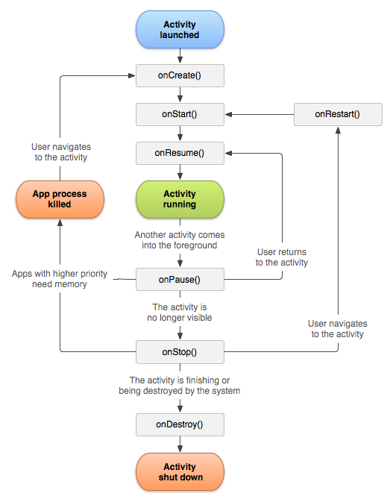
ACTIVITY LIFECYCLES
Collection of callback methods to inform object state condition
Activity, Fragment and ViewModel has its own lifecycle

Slide 5
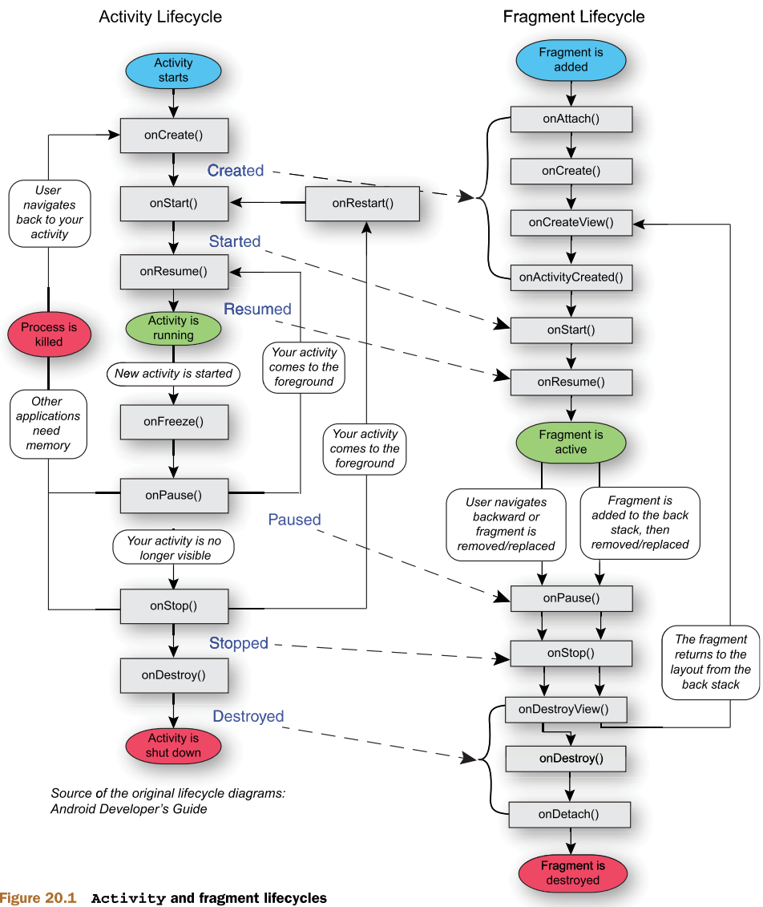
FRAGMENT LIFECYCLES
Fragment lifecycles more complex
Fragment must be attached first
At least need one activity to hold/handle a fragment

Slide 6
COMPLEX MICRO MANAGEMENT
Handle asynchronous calls
Handle configuration changes
Data update
Memory leak problem
Notes:
Memory leak problem: A memory leak happens when your code allocates memory for an object, but never deallocates it. These garbage will pileup and eventually affect system/app performance
Handle Async Calls
asynchronous calls may take some time to return. The UI controller needs to manage these calls and ensure the system cleans them up after it's destroyed to avoid potential memory leaks. Waste of resource.
Handle Configuration changes
Some device configurations can change during runtime (such as screen orientation, keyboard availability, and when the user enables multi-window mode). When such a change occurs, Android restarts the running Activity ( onDestroy() is called, followed by onCreate() )
Data Update
If the system destroys or re-creates a UI controller, any transient UI-related data you store in them is lost. It means, each related lifecycles should be handled properly to refetch the data.

Slide 7
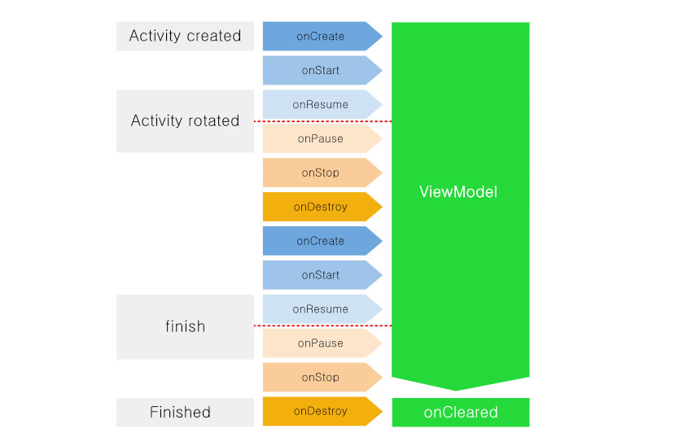
VIEWMODEL LIFECYCLES
ViewModel encapsulate the data for a UI controller to let the data survive configuration changes
ViewModel offer much more simple lifecycles
ViewModel is lifecycle aware
ViewModel have one method to handle those state

Slide 8
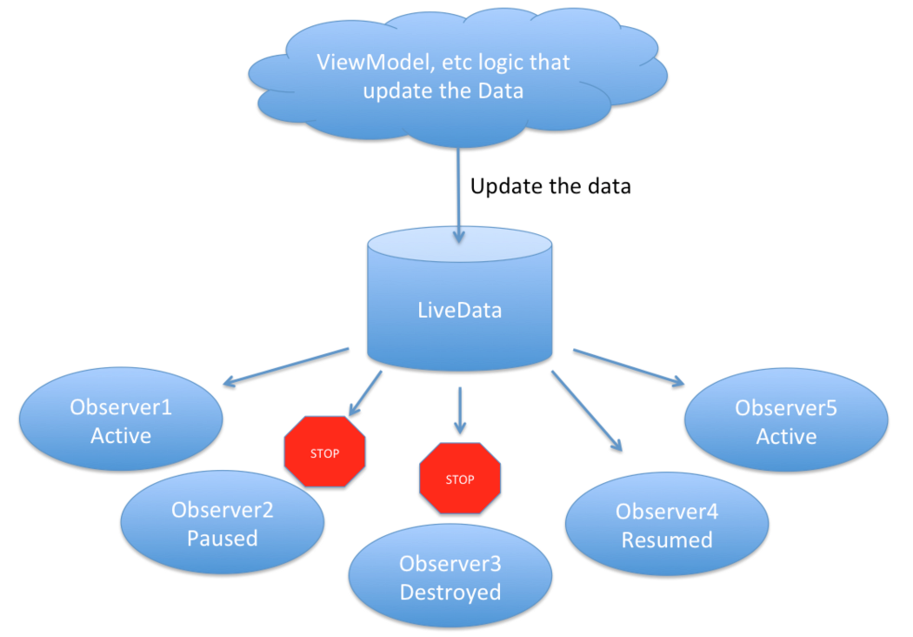
LIVEDATA
Observable is an object that emit value/data
Observer is attached to the observable and receive the data that observable emit
LiveData is an observable data holder class and its lifecycle-aware
LiveData only notifies active observers about updates (and livedata aware that)

Slide 9
LIVEDATA
No memory leaks
Always up to date data
Manages configuration changes

Slide 10
MVVM
Model View View Model Architecture

Slide 11
MVVM ARCHITECTURE
Without architecture -> all UI logic and I/O logic handle by single activity -> God Object
Provide a way to structure our code in a way that provides some advantages in this terms: separate the business and presentation logic from the UI (means that the model don’t need to know what view/view model doing)
It’s associated with View, Model, and ViewModel

Slide 12
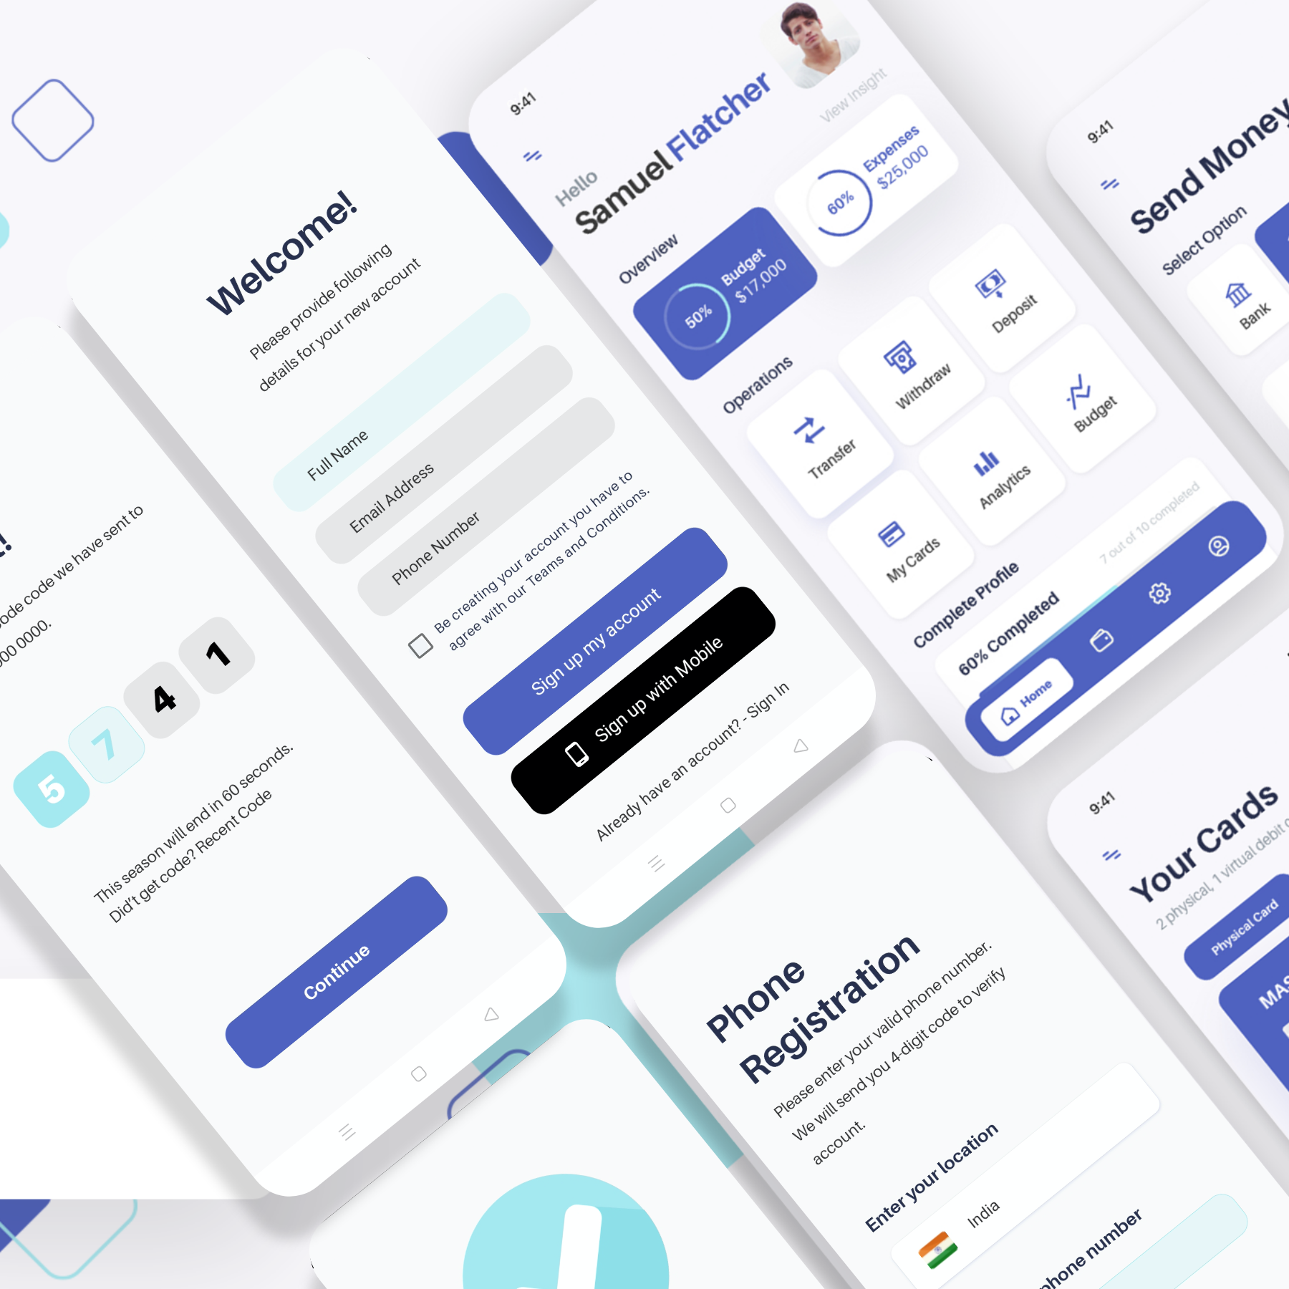
VIEW
View is responsible for the layout structure displayed on the screen.
You can also execute UI logic.

Slide 13

MODEL
Model is a non-visual class that has the data to use
Usually we retrieve data from REST-API in form of JSON, or from internal sqlite database (DAO)

Slide 14
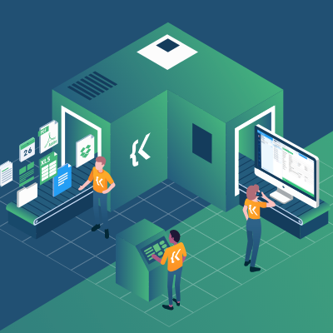
VIEWMODEL
The ViewModel implements the data and commands connected to the View to notify the View of state changes via change notification events.
View that receives the state change notification determines whether to apply the change ViewModel prepare the data for View

Slide 15
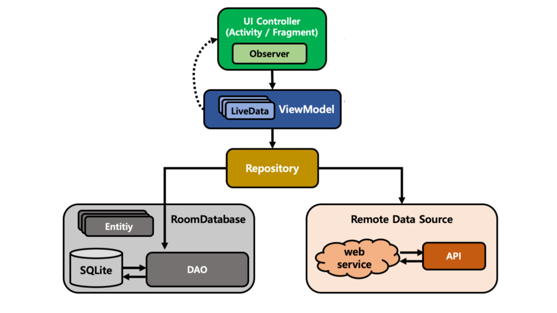
MVVM ARCHITECTURE

Slide 16
THE TUTORIAL
2
Develop project that uses MVVM architecture

Slide 17
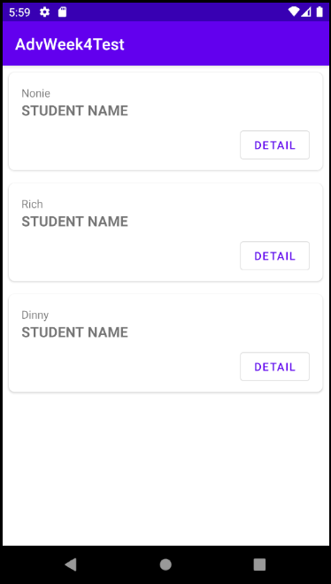
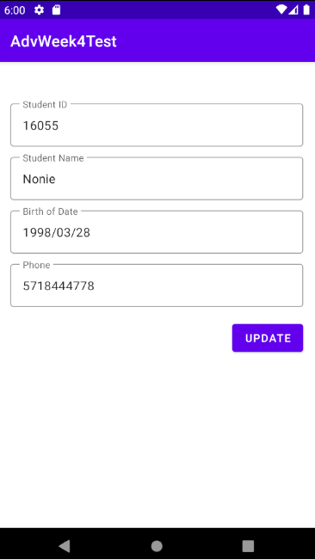
STUDENT LIST
A classic example of data in list

Slide 18
CREATE A NEW PROJECT
Start a new Android Studio Project, name it as “AdvWeek4”
Use default project configuration and template
Create a new github repo with any name according to your preferences
Connect/establish the github repo to this project, and make your first commit and push

Slide 19
SETUP DEPENDENCIES
As usual we need to include safeargs dependencies and activate Kotlin extensions
Open build.gradle (module) and look at the plugins object on top. Add following lines of configuration:
plugins {
id 'com.android.application'
id 'kotlin-android'
id 'kotlin-android-extensions'
id 'androidx.navigation.safeargs.kotlin'
}

Slide 20
SETUP DEPENDENCIES
Now open the build.gradle (project), and add following config at the top, then don’t forget to sync now:
buildscript {
repositories {
google()
}
dependencies {
classpath 'androidx.navigation:navigation-safe-args-gradle-plugin:2.4.1'
}
}

Slide 21
THE VIEWS
3

Slide 22
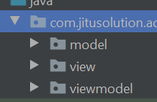
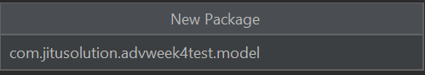
CREATE PACKAGES
Project should be structured in MVVM way to make it clear and tidy
Create three new packages “model”, “view”, and “viewmodel”
Steps:
Right click on package name > new > package
Type package name

Slide 23
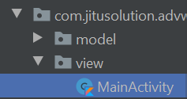
MOVE ACTIVITY
According to MVVM architecture, every object that related with UI logic must be placed inside “view” package
This include activities
Drag and drop current MainActivity.kt inside the “view”
Go with the default and click “refactor”
Build > rebuild project to see the changes

Slide 24
CREATE FRAGMENTS
In “view” package, create two fragments:
StudentListFragment Layout -> fragment_student_list.xml
StudentDetailFragment Layout -> fragment_student_detail.xml

Slide 25
STUDENT LIST LAYOUT
Delete the default “textview” and add “constraint layout”
Open the xml codes to add following xml manually: <FrameLayout . . . > <androidx.swiperefreshlayout.widget.SwipeRefreshLayout
android:layout_width="match_parent"
android:layout_height="match_parent"
tools:context=".view.StudentListFragment"> <constraint layout. . . /> </androidx.swiperefreshlayout.widget.SwipeRefreshLayout>
</FrameLayout>

Slide 26
SWIPE REFRESH LAYOUT
It detects the vertical swipe, displays a distinctive progress bar, and triggers callback methods in your app (usually initiate fetching data action)

Slide 27
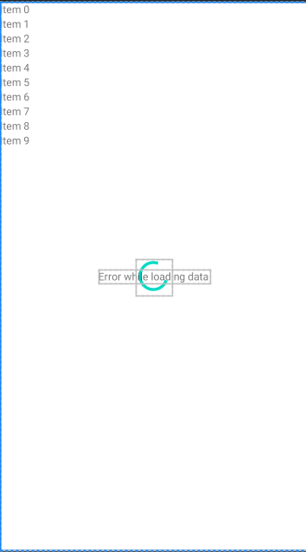
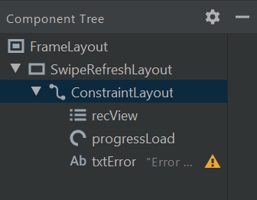
RecyclerView
Progress Bar
Text View

Slide 28
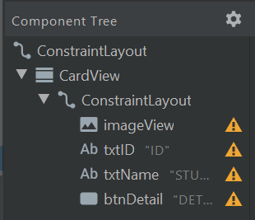
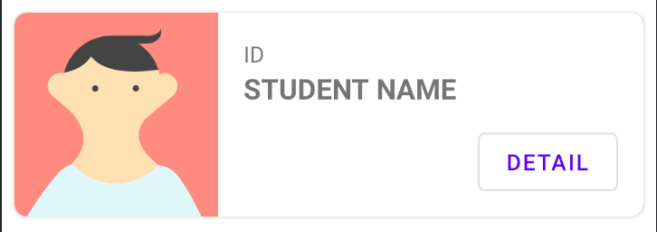
STUDENT LIST ITEM LAYOUT
Recycler View needs item layout to render each data into the list
Create a new layout, name it as “student_list_item.xml”

Slide 29
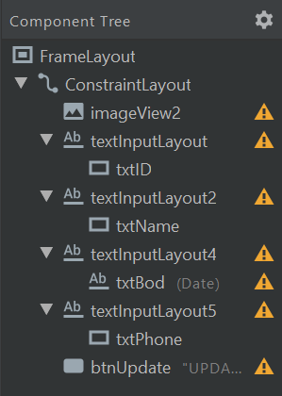
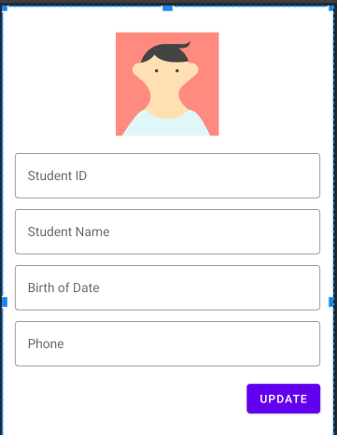
FRAGMENT STUDENT DETAIL LAYOUT
Mostly its used TextInputLayout with Material Design Outline Style

Slide 30
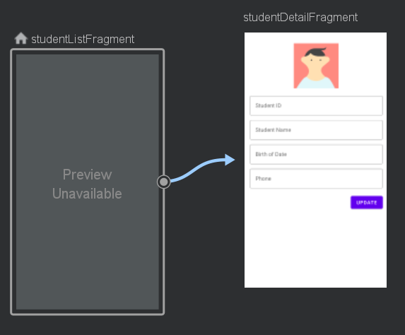
Id = actionStudentDetail
NAVIGATION GRAPH
Next create new navigation graph, name it as “main_navigation.xml” Dont forget to rebuild after finished

Slide 31
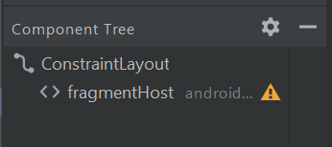
SETUP HOST FRAGMENT
Open activity_main.xml, delete the default text view.
Drag and drop “host fragment”
Choose the “main_navigation”
Set it full widht and height
Set id to “fragmentHost”

Slide 32
THE MODEL
4

Slide 33
CREATE MODEL
Model is just simple file that hold “data” blueprint in form of data class.
Model may have more than one class
Right click on package “model” > new > Kotlin/Class file
Named it as “Model”, choose “File” and then press enter key

Slide 34
DATACLASS STUDENT
To simplify things, our model only accept “String”
dob is “date of birth”
data class Student(
val id:String?,
val name:String?,
val dob:String?,
val phone:String?,
val photoUrl:String?
)

Slide 35
CREATE ADAPTER
To make Recycler View work as intended, than we need to supply it with adapter
Right click on “view” package > new > “Kotlin/File class”
Named it as “StudentListAdapter”
Choose “class”, and then press enter
Why this adapter put in the “View” package? Why don't we put it in the “Model” package?

Slide 36
CREATE ADAPTER
This adapter requires ArrayList data of Student
class StudentListAdapter(val studenList:ArrayList<Student>) {
class StudentViewHolder(var view: View) : RecyclerView.ViewHolder(view)
}
This is an inner class that primarily used by the adapter to update the UI

Slide 37
CREATE ADAPTER
class StudentListAdapter(val studenList:ArrayList<Student>) :RecyclerView.Adapter<StudentListAdapter.StudentViewHolder>() {
class StudentViewHolder(var view: View) : RecyclerView.ViewHolder(view)
}
Extend the class to RecyclerView.Adapter that requires the innerclass “student view holder”

Slide 38
IMPLEMENTS ALL MEMBER
override fun onCreateViewHolder(parent: ViewGroup, viewType: Int):StudentViewHolder {
}
override fun onBindViewHolder(holder: StudentViewHolder, position: Int) { } override fun getItemCount(): Int { return studenList.size }
Use auto-complete helper from android studio. Do not type these all manually!

Slide 39
CREATE VIEW HOLDER
override fun onCreateViewHolder(parent: ViewGroup, viewType: Int): StudentViewHolder {
val inflater = LayoutInflater.from(parent.context)
val view = inflater.inflate(R.layout.student_list_item, parent, false)
return StudentViewHolder(view)
}
Load the views that will be rendered on each item in the list

Slide 40
BIND VIEW HOLDER
override fun onBindViewHolder(holder: StudentViewHolder, position: Int) {
holder.view.txtID.text = studenList[position].id
holder.view.txtName.text = studenList[position].name
}

Slide 41
BUTTON DETAIL LISTENER
override fun onBindViewHolder(holder: StudentViewHolder, position: Int) {
holder.view.txtID.text = studenList[position].id
holder.view.txtName.text = studenList[position].name holder.view.btnDetail.setOnClickListener {
val action = StudentListFragmentDirections.actionStudentDetail()
Navigation.findNavController(it).navigate(action)
}
}
Button Detail is used to navigate to the Student Detail screen

Slide 42
UPDATE STUDENT LIST FUNCTION
The main purpose of this function is to “refresh” student data list
fun updateStudentList(newStudentList: List<Student>) {
studenList.clear()
studenList.addAll(newStudentList)
notifyDataSetChanged()
}
tells the recycler view that every single item should be updated.

Slide 43
THE VIEW MODEL
5

Slide 44
CREATE VIEW MODEL
The ViewModel class is designed to store and manage UI-related data in a lifecycle conscious way. View model provide a way to emit the data to observer.
Create a new Kotlin class in “viewmodel” package, named it as “ListViewModel.kt”
This ListViewModel is used as bridging operation between student model and fragment list

Slide 45
LISTVIEW MODEL
Extends View Model
class ListViewModel:ViewModel() {
val studentsLD = MutableLiveData<List<Student>>()
val studentLoadErrorLD = MutableLiveData<Boolean>()
val loadingLD = MutableLiveData<Boolean>()
studentsLD = live data that “emit” students data (in list form)
studentLoadErrorLD = live data that “emit” error status (boolean)
loadingLD = live data that “emit” data loading status (boolean)
MutableLiveData is type of LiveData that updateable

Slide 46
REFRESH FUNCTION
Copy from here: https://pastebin.com/GUtGT9hG
Hardcoded data. In the next lecture will be replaced with actual data from external sources
fun refresh() {
val student1 = Student("16055","Nonie","1998/03/28","5718444778","http://dummyimage.com/75x100.jpg/cc0000/ffffff")
val student2 = Student("13312","Rich","1994/12/14","3925444073","http://dummyimage.com/75x100.jpg/5fa2dd/ffffff")
val student3 = Student("11204","Dinny","1994/10/07","6827808747","http://dummyimage.com/75x100.jpg/5fa2dd/ffffff1")
val studentList:ArrayList<Student> = arrayListOf<Student>(student1, student2, student3)
studentsLD.value = studentList
studentLoadErrorLD.value = false
loadingLD.value = false
}
Refresh function in real case used to load data from server/local and prepare livedata objects. Ready to be observed

Slide 47
USE VIEW MODEL
Next step is to use the view model in StudentListFragment
Open StudentListFragment.kt, create two object:
class StudentListFragment : Fragment() {
private lateinit var viewModel:ListViewModel
private val studentListAdapter = StudentListAdapter(arrayListOf())

Slide 48
INITIALIZE VIEW MODEL
Override onViewCreated, and then initialize and call refresh function
viewModel = ViewModelProvider(this).get(ListViewModel::class.java)
viewModel.refresh()
recView.layoutManager = LinearLayoutManager(context)
recView.adapter = studentListAdapter
observeViewModel()
Initalize the adapter

Slide 49
OBSERVE VIEW MODEL FUNCTION
This function set actions for observer about how to handle the emitted data
fun observeViewModel() {
}

Slide 50
OBSERVE VIEW MODEL FUNCTION
fun observeViewModel() { viewModel.studentsLD.observe(viewLifecycleOwner, Observer {
studentListAdapter.updateStudentList(it)
})
}
This observe function is used to “observe” Students data
Any program under the Observer function will be executed if needed (ie. activity state changed, configuration changed, etc)
Students LiveData (observable) attached to this fragment (observer). Every time observer changes its state, the observable emit the data

Slide 51
OBSERVE VIEW MODEL FUNCTION
viewModel.studentLoadErrorLD.observe(viewLifecycleOwner, Observer {
if(it == true) {
txtError.visibility = View.VISIBLE
} else {
txtError.visibility = View.GONE
}
})
This observe “loading error” livedata. For now its just use dummy data

Slide 52
OBSERVE VIEW MODEL FUNCTION
viewModel.loadingLD.observe(viewLifecycleOwner, Observer {
if(it == true) {
recView.visibility = View.GONE
progressLoad.visibility = View.VISIBLE
} else {
recView.visibility = View.VISIBLE
progressLoad.visibility = View.GONE
}
})
This observe “loading” livedata. For now its just use dummy data

Slide 53
HOMEWORK
6

Slide 54
CREATE VIEW MODEL
Create new ViewModel to handle the StudentDetailFragment
Name it as “DetailViewModel.kt”
class DetailViewModel:ViewModel() {
val studentLD = MutableLiveData<Student>()
}
This DetailViewModel only handle single Student Data

Slide 55
FETCH FUNCTION
Create fetch function (it has same function like “refresh”)
class DetailViewModel:ViewModel() {
val studentLD = MutableLiveData<Student>()
fun fetch() {
val student1 = Student("16055","Nonie","1998/03/28","5718444778", "http://dummyimage.com/75x100.jpg/cc0000/ffffff")
studentLD.value = student1
}
}
Prepare single dummy data student

Slide 56
USE THE DETAIL VIEW MODEL
Your job is to use this new view model in StudentDetailFragment
Hints:
- call fetch function in StudentDetailFragment.kt
- make observer for the “Student” livedata
- Ignore button update
- use setText method to change the edit text value

Slide 57
DUE DATE
You must commit + push not exceeding the date (see the due date on ULS)
Submit the github link to ULS

Slide 58
THANKS!
Any questions?
You can find me at
andre@staff.ubaya.ac.id

